Slide 1

Identification of Crime Prone Areas Project Synopsis Presentation Date: 15/10/2022
Project Work Phase-I ML (EAI753)
Degree : B.Tech(AI+ML+DL)
Project Guide:
Mr. Ashish Bishnoi
Dr. Saurabh Pathak
Submitted By:
Aashvi Jain (TCA1959004)
Divyanshu Jain (TCA1959012)
FACULTY OF ENGINEERING & COMPUTING SCIENCES
TEERTHANKER MAHAVEER UNIVERSITY, MORADABAD

Slide 2

Team Details
Student Name | Role
Aashvi Jain | Developer, Testing
Divyanshu Jain | Developer, Data Analyzer
2
T011A/ Template Version 5.0

Slide 3
Project Brief
We have identified the problem of the increase of criminal activity at a high rate and also analyze the root cause of this rapid increase in crime rate.
We have analyzed the current traditional methods of Crime identification and on the basis of the dataset of 112 Helpline we come up with this solution.
In the proposed system, we have done crime data analysis of with many parameters and factors including Event Id, Circle name, Police Station, Caller source, Event Type, Event-sub-type, Data of crime, Latitude, and Longitude of the location of the crime.
Our system can predict the type of criminal activity which have a high probability for a given location in terms of latitude and longitude and date and also we can visualize crime-prone areas.
. We have plan to develop a webpage for the end user and to integrate our model with that webpage so that we can visualize the results on frontend.
3
T011A/ Template Version 5.0

Slide 4
Methodologies/ Technologies/ Tools to be used
Literature Survey and Planning
Data Collection
Data Preprocessing
Feature Selection
Dataset Splitting
Model Training
Model Testing
Retraining of Model (if Required)
Deployment
Libraries Used:
Numpy
Pandas
SeaBorn
Matplotlib
Plotly
Sklearn
Flask
4
T011A/ Template Version 5.0

Slide 5
Methodologies/ Technologies/ Tools to be used
Hardware Platform:-
Tools :-
1. Jupyter Notebook
2. Visual Studio Code
Component | Specification
Operating System | Windows 7 or Higher
RAM | Minimum 4 GB
Processor | Above 500 MHz
Browser | Chrome, Edge
Hard Disk | 1GB Minimum
5
T011A/ Template Version 5.0

Slide 6
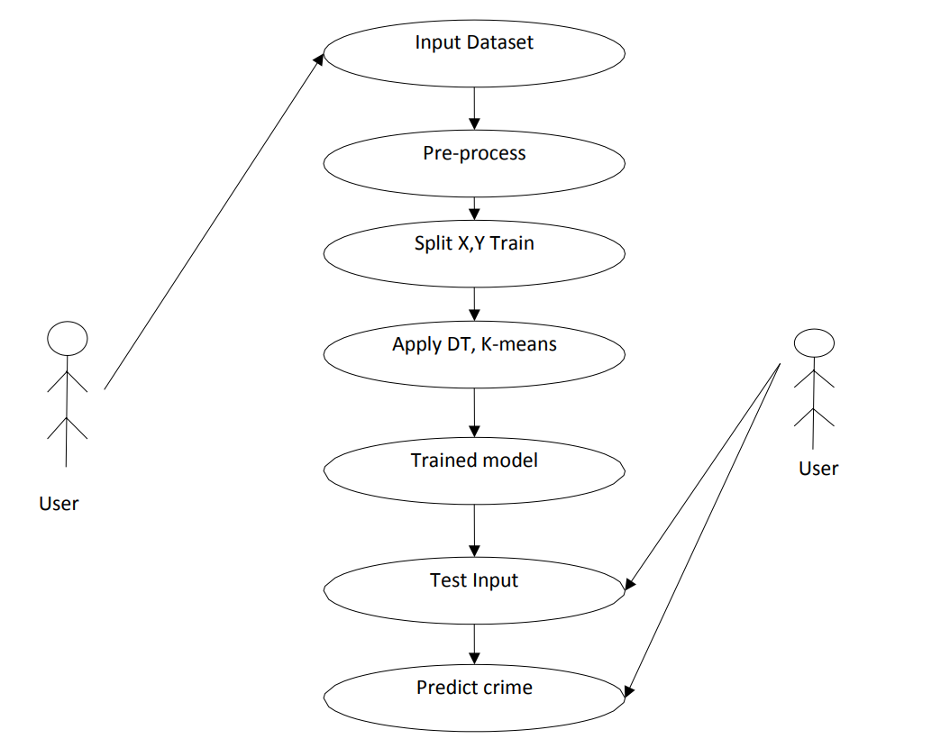
USE CASE DIAGRAM (ML Model):
6
T011A/ Template Version 5.0

Slide 7
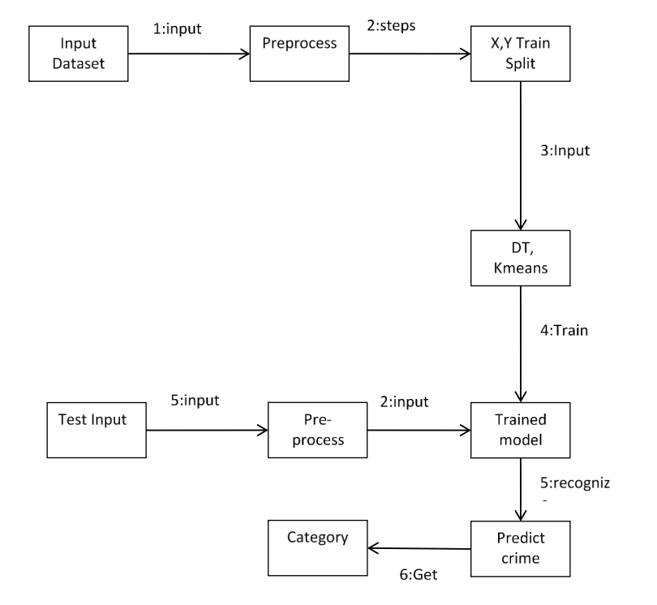
COLLABORATION DIAGRAM:
7
T011A/ Template Version 5.0

Slide 8
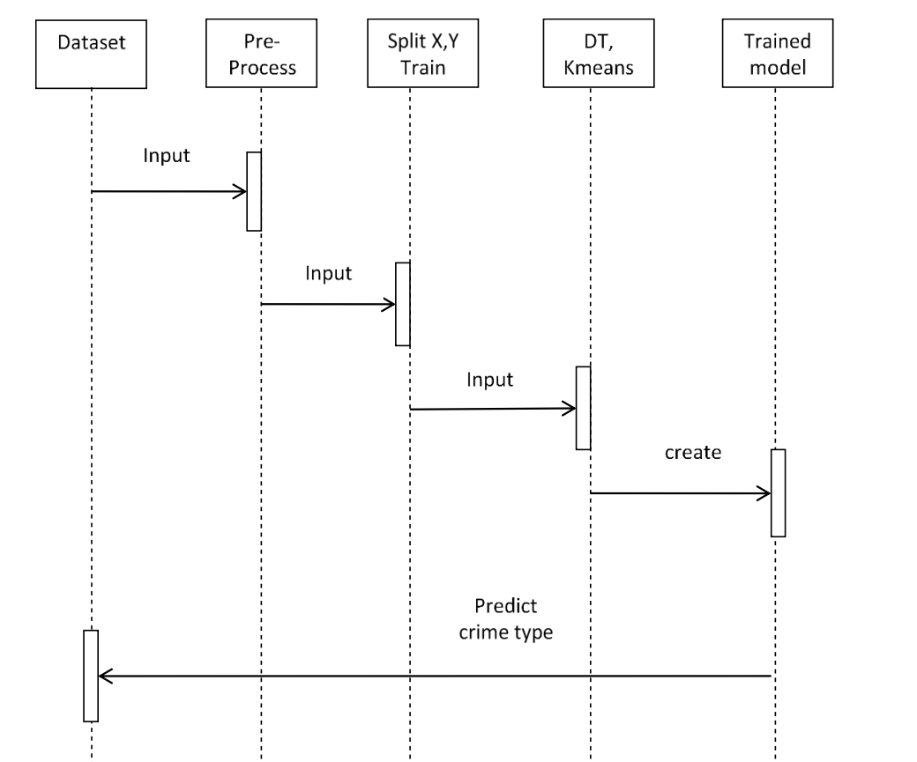
SEQUENCE DIAGRAM:
8
T011A/ Template Version 5.0

Slide 9
\
Advantage of The Project
Identify the Crime Prone Areas in a efficient way.
Reduce the Chances of Crimes.
Help Police and administrative authorities for planning better preventive measures.
Ensure Strong Public Safety.
Can be easily access by the end user through web page.
9
T011A/ Template Version 5.0

Slide 10
References
1. www.analyticsvidhya.com
2. https://www.altexsoft.com
3. https://towardsdatascience.com
4. manthan.mic.gov.in
6. www.researchgate.net
10
T011A/ Template Version 5.0

Slide 11
THANKS

